Slide 1
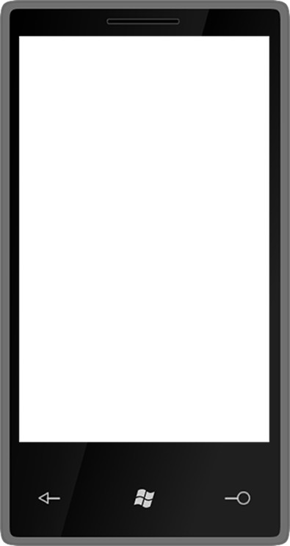
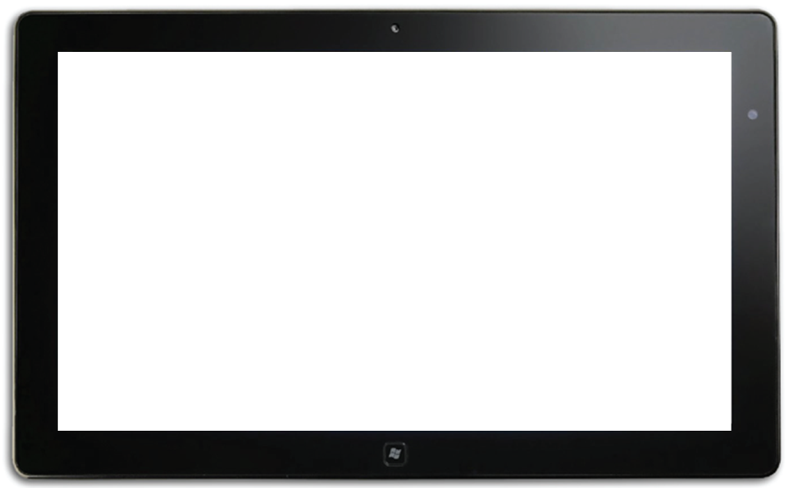
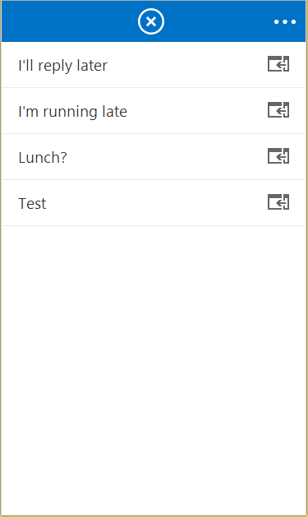
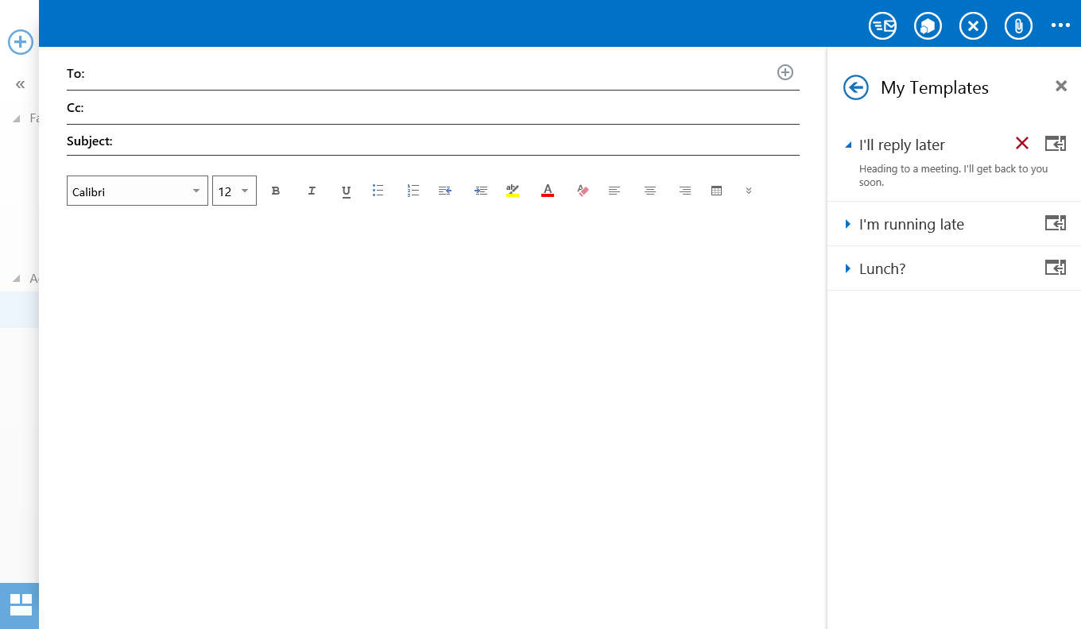
Compose App Activation
Apps can appear in messages and/or appointments
Compose apps are across Desktop, Tablet and Mobile

Slide 2
Compose mail app capabilities
Use core JS APIs
Read/Write recipients
Read/Write subject
Add attachments
Write to the body
R/W appointment properties
Custom item properties
User Identity Token
Make EWS requests
Settings
User Profile

Slide 3
Compose mail app capabilities
Use core JS APIs
Read/Write recipients
Read/Write subject
Add attachments
Write to the body
R/W appointment properties
Custom item properties
Get/set/add recipients or
attendees
Get/set the subject

Slide 4
Compose mail app capabilities
Use core JS APIs
Read/Write recipients
Read/Write subject
Add attachments
Write to the body
R/W appointment properties
Custom item properties
Add file or item attachments

Slide 5
Compose mail app capabilities
Use core JS APIs
Read/Write recipients
Read/Write subject
Add attachments
Write to the body
R/W appointment properties
Custom item properties
Prepend to the body
Overwrite current selection in body

Slide 6
Compose mail app capabilities
Use core JS APIs
Read/Write recipients
Read/Write subject
Add attachments
Write to the body
R/W appointment properties
Custom item properties
Get/set start or end time
Get/set location
Get/set/add attendees

Slide 7
Compose mail app capabilities
Use core JS APIs
Read/Write recipients
Read/Write subject
Add attachments
Write to the body
R/W appointment properties
Custom item properties
Saved on the sent item
Can be used to mark a composed message (eg “Tracked” in CRM)

Slide 8
demo
Creating a Compose Mail App

